Slide 1
MouseBot
Ryan Holleran Embedded System Design

Slide 2
MouseBot Details
MouseBot is a mouse-like robot, without being a pest. MouseBot will have multiple proximity sensors, and will sense when something is close to it. When something is close to it, it will sense where that object is, and then will run away from the object. If the MouseBot gets near a wall, or another object, will try to get away from all the objects, and try to run away until its safe again.

Slide 3
Bill Of Materials
Description | Item | Amount | Price | Cost | Supplied?
IR Photodiode | OP245A | 4 | $0.74 | $2.96
IR Emitter | LTR-4206E | 12 | $0.38 | $4.56
Resistor | Misc. Values | 12 | $0.04 | $0.53
Microcontroller | KL25Z | 1 | $12.95 | $12.95 | Yes
Robot Shield | 130-35000 | 1 | $134.99 | $134.99 | Yes
Misc. | Wires, Etc. | 1 | $10.00 | $10.00 | Yes
Total |  |  |  | $165.99
Total (minus supplied parts) |  |  |  | $8.05

Slide 4
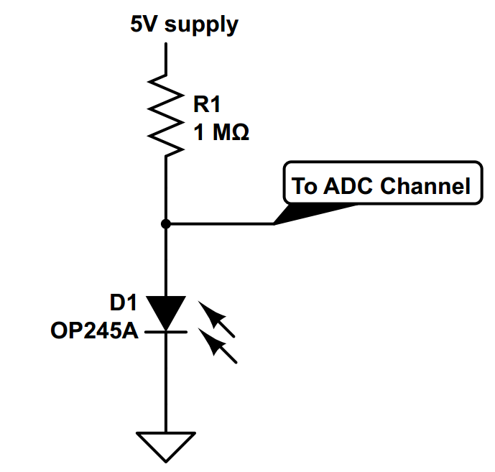
IR Photodiode Sensor Schematic
There are 4 of these.
Notes:
There is one of these on each breadboard

Slide 5
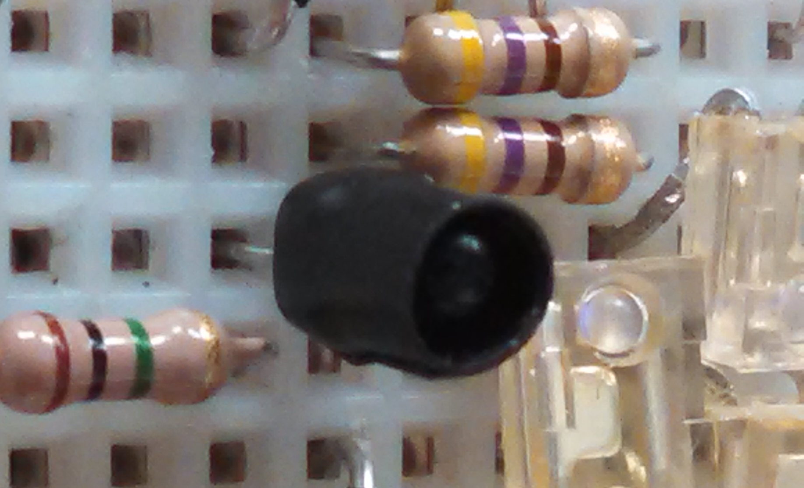
IR Photodiode
Had troubles getting a consistent ADC Voltage
Solved this problem by wrapping the photodiode in electrical tape to block out IR light from the sides

Slide 6
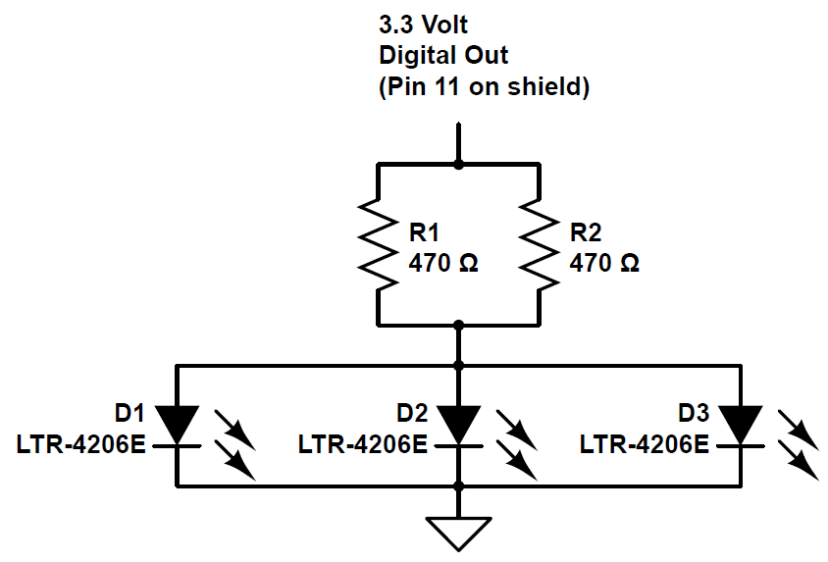
IR LED Diode Schematic
There are 4 of these, also.
Notes:
There is one of these on each breadboard as well

Slide 7
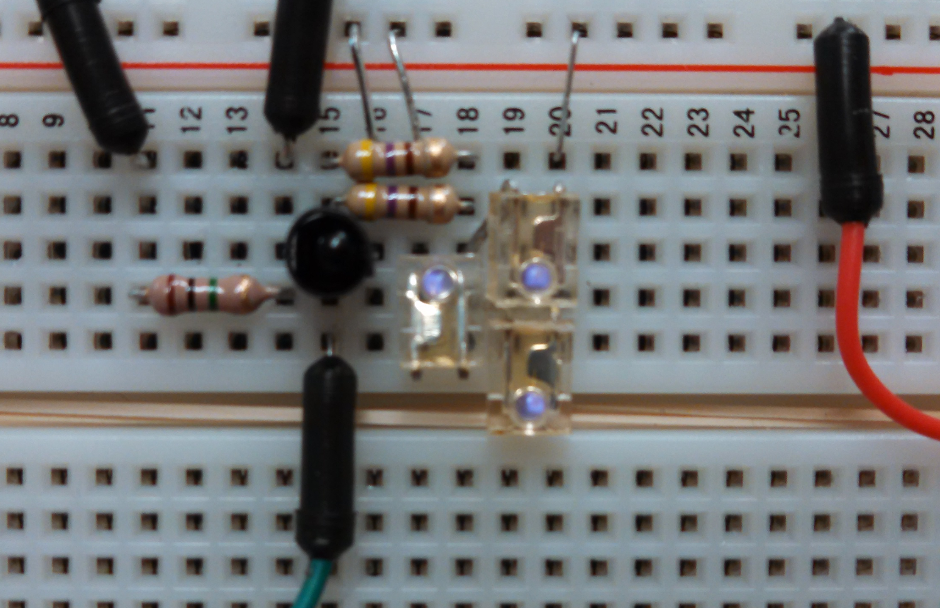
On the Breadboard
Notes:
Nice and tightly packed components.

Slide 8
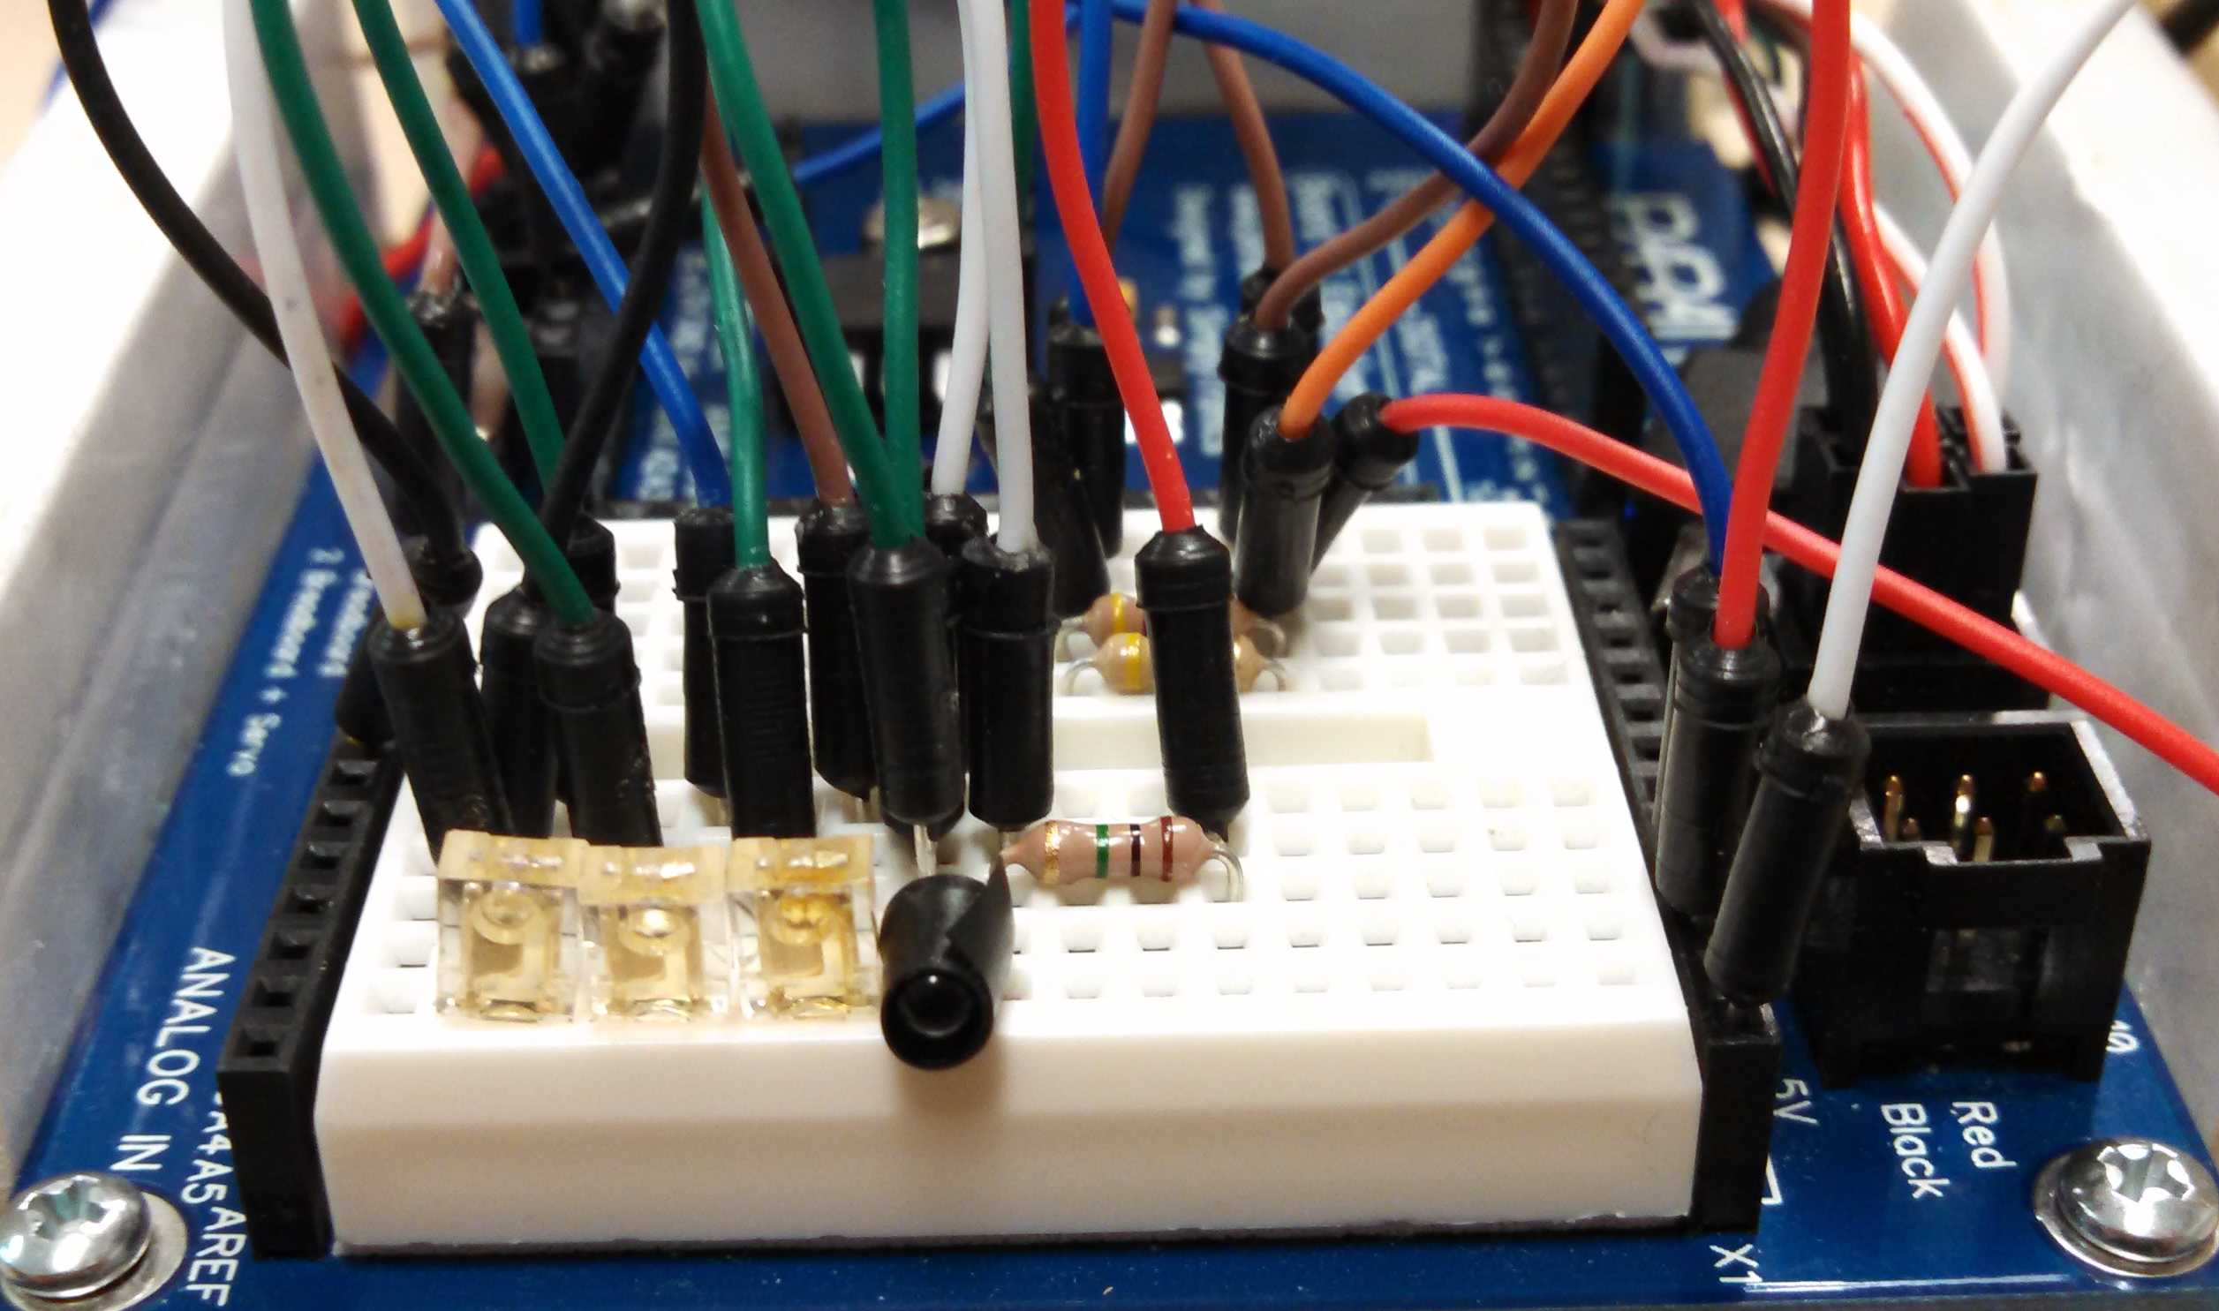
On the Robot
Notes:
The Back sensor, the only sensor not on a vertical breadboard

Slide 9
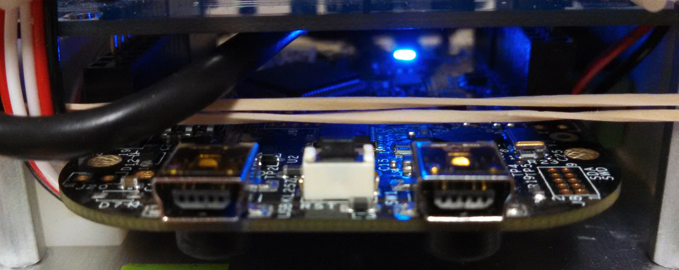
FRDM KL25z Mounted
Notes:
Looked at the instructions for the robot shield and mounted the FRDM board so that the shield pins could be used

Slide 10
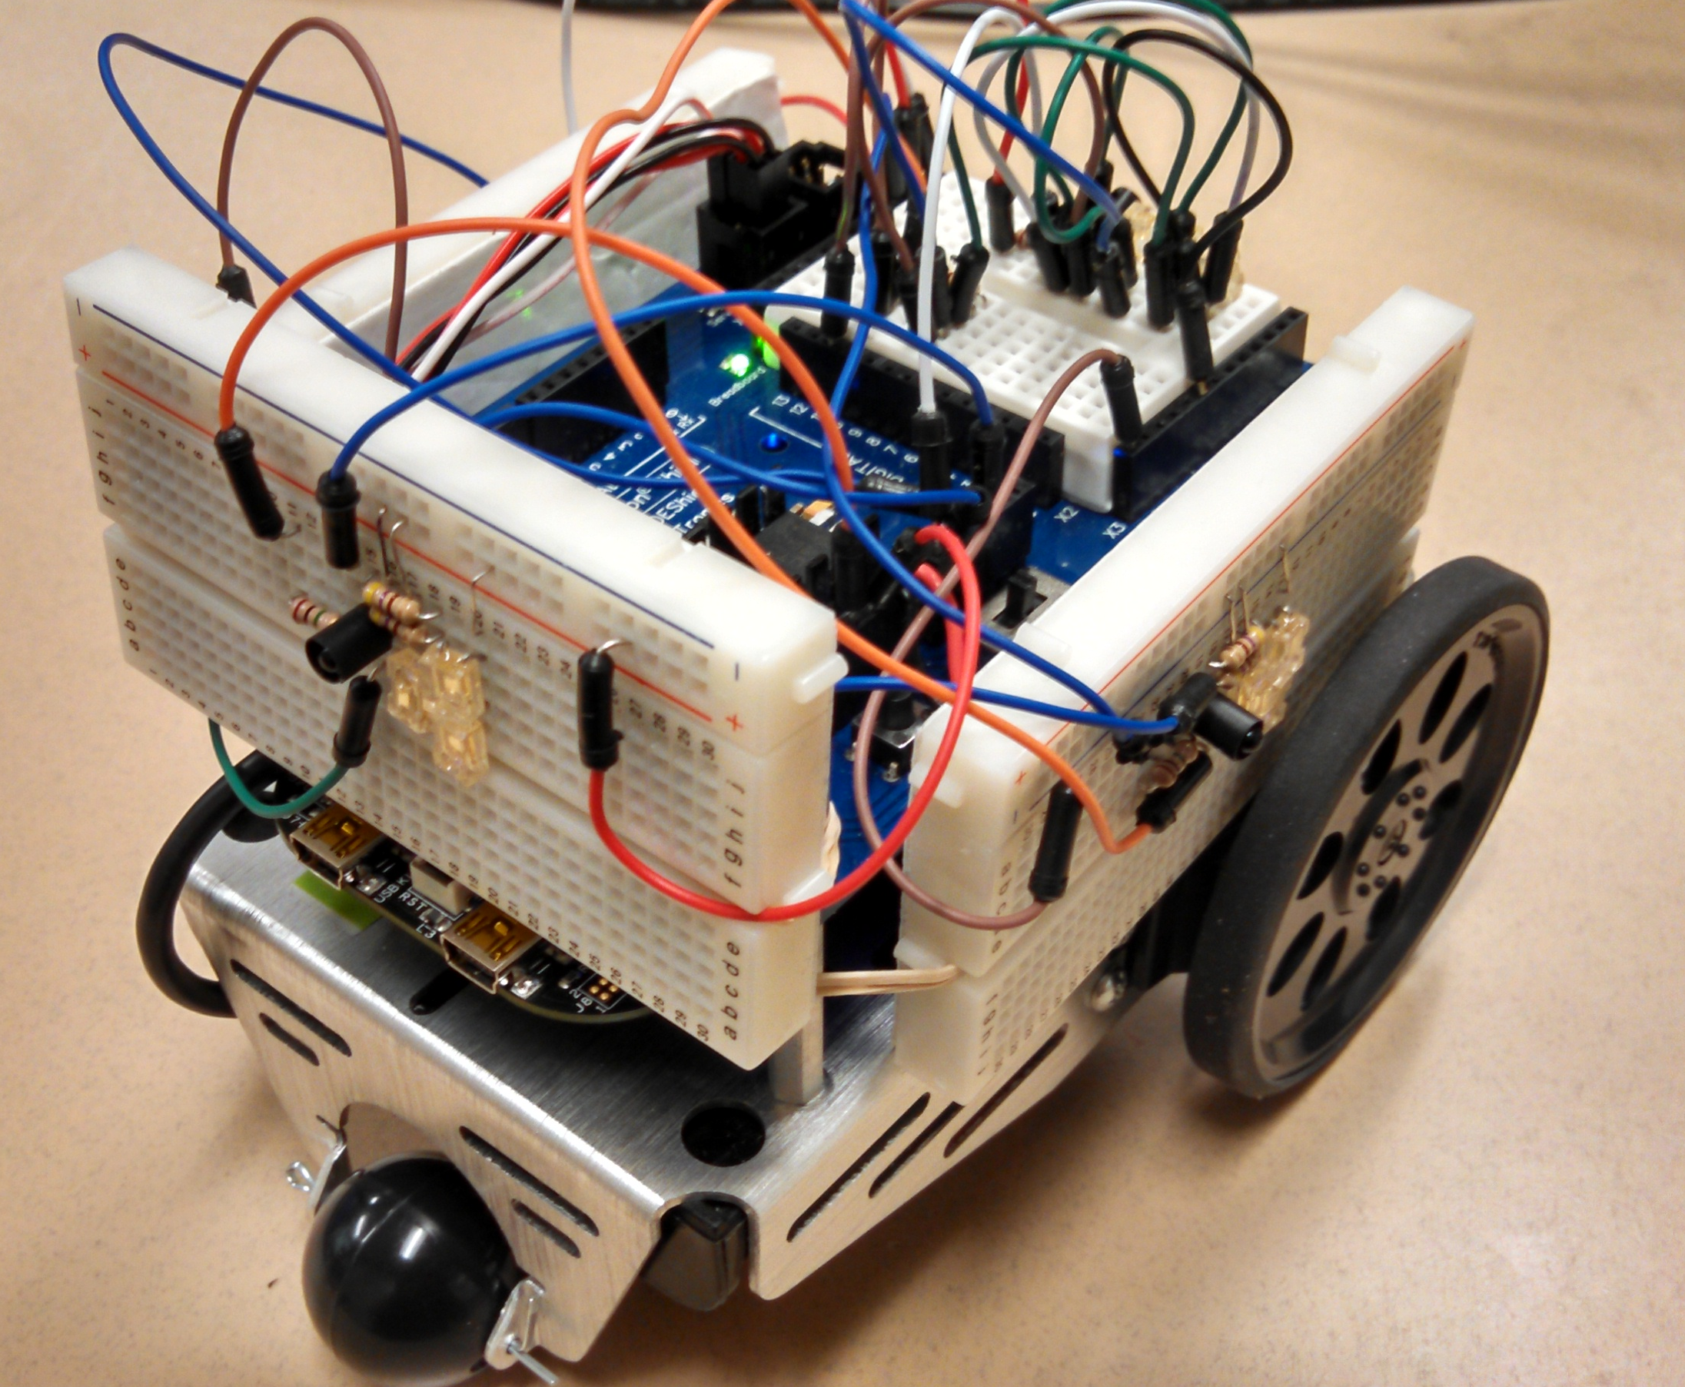
The Robot
Notes:
Rubber banded bread boards to the robot shield
Sacrificed some jumper wires by bending the leads, oh well.

Slide 11
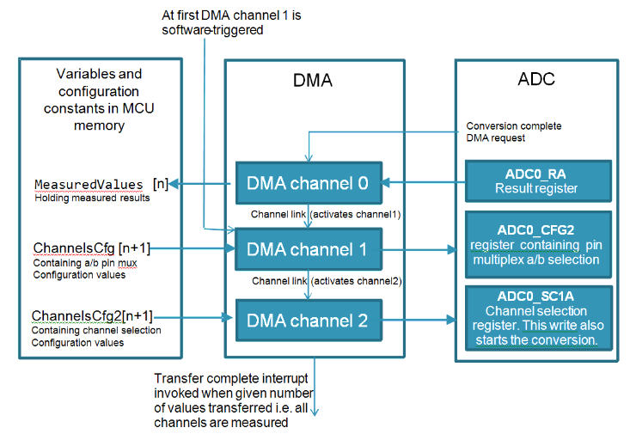
Getting ADC input using DMA
Notes:
DMA will set the register values of the ADC to get the ADC information from the ADC channel you are interested in
Cfg is the channel number
Cfg2 is the Pin A/B info for that channel.

Slide 12
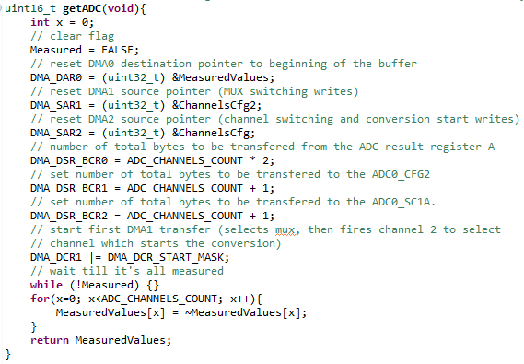
DMA Accessing ADC and recording values
Notes:
Was easy to implement with a tutorial from freescale.

Slide 13
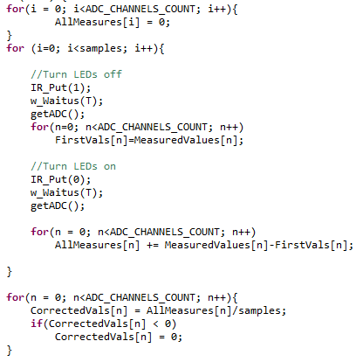
Getting an averaged ADC sample
Notes:
Problem – had lots of overflow errors from using the wrong type of variable.

Slide 14
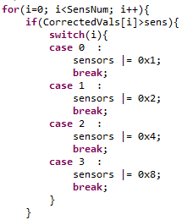
Sensors get Triggered
Notes:
Used an unsigned int to act like a register to indicate which sensors are triggered.
OR operator sets the bit

Slide 15
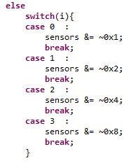
Sensors get De-Triggered
Notes:
AND operator clears the bit
* bit 0 : Rear
* bit 1 : Left
* bit 2 : Right
* bit 3 : Front

Slide 16
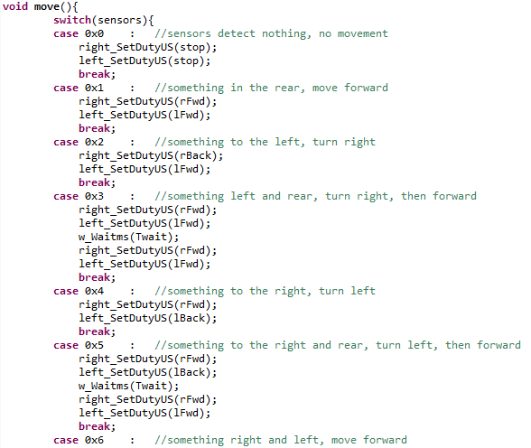
Deciding where to go
Notes:
Many ways of doing this, this is the most brute force method, in my opinion.

